Slide 1
Underline the presenting author’s name
List all authors/contributors
Presenter & Co-Authors:
John Smith, Jane Doe, Mark Brown
Affiliation:
Department of Organic Chemistry
Faculty of Chemistry, University of Gdańsk, Poland
Department of Example, Faculty of Example, University of Example, City, Country
(If needed, include multiple affiliations for different authors.)
Study of the fibrillization process of short peptide fragments
(Use a clear, bold font for the title.)
Contact Information:
Email: john.smith@example.edu
Website: https://nsbc.ug.edu.pl/
Date: May 10, 2025

Slide 2
MAIN GUIDELINES
Insert Conference Logo on the title slide
(please include the conference logo on the title slide,
if it is possible, it can be placed on the other slides as well)
Introduction
full logo
simplified logo
Content organization:
Make sure each slaid is clear and readable. Use appropriate graphics, charts and photos to visually support the information presented. Try to strike a balance between text and graphics so that the message is clear and visually appealing.
3

Slide 3
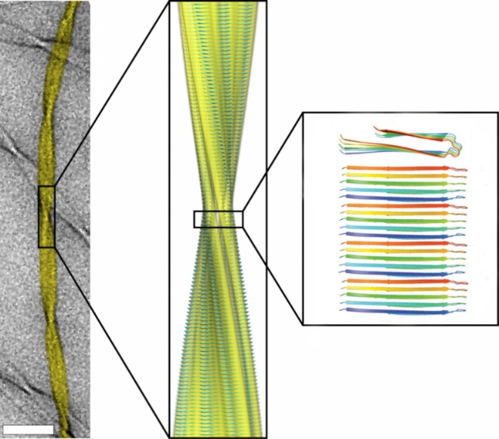
Amyloid fibrils
This is an example of a presentation. Pay attention when preparing your presentation to make sure the text is visible to your audience.
Constructed of β-sheets successively superimposed on each other;
Highly ordered
Capable of self-association
Cause diseases of amyloidogenic origin, e.g. Alzheimer's disease
Figure 1. Microscopic image of amyloid fibrils (A), model of the fibril structure (B) composed of parallel arranged beta sheet structures (C).
6

Slide 4
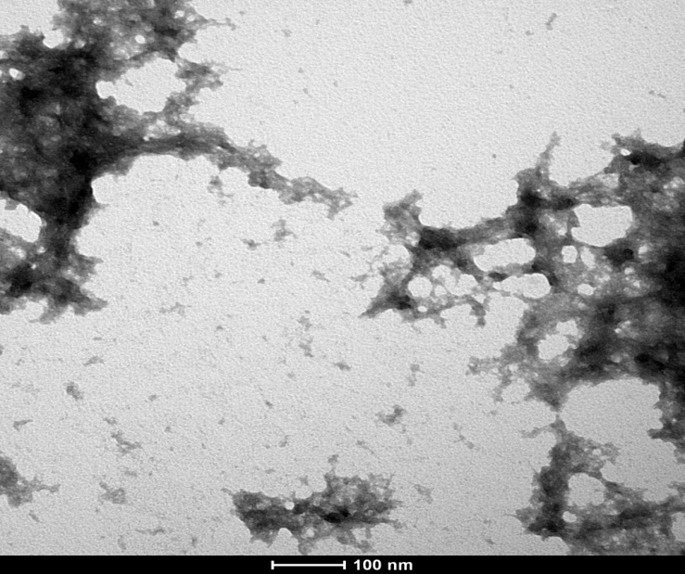
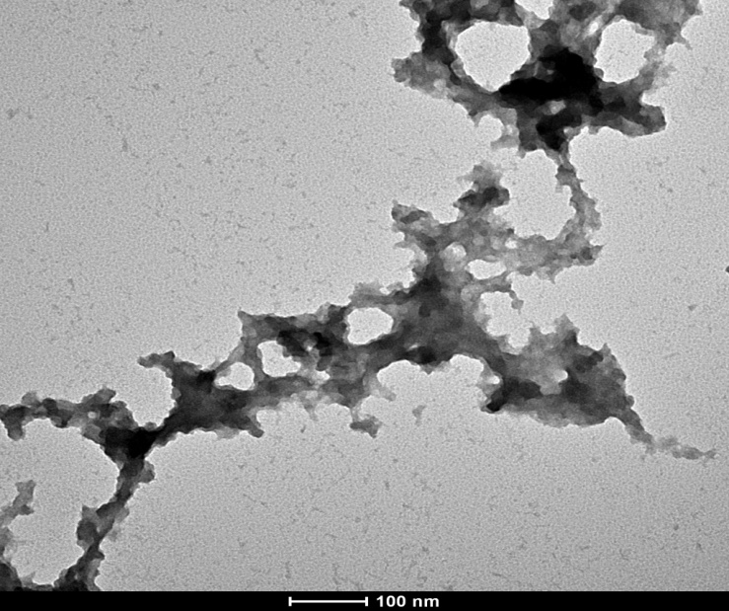
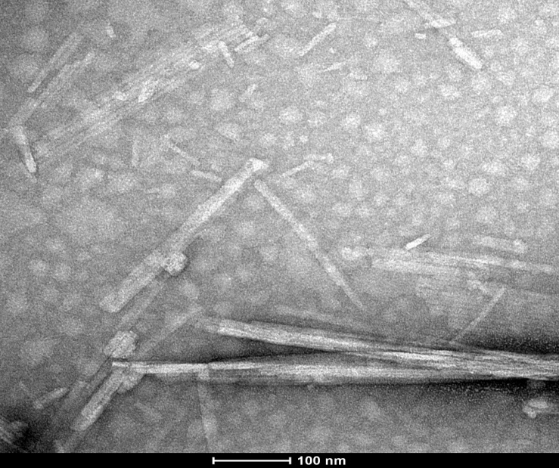
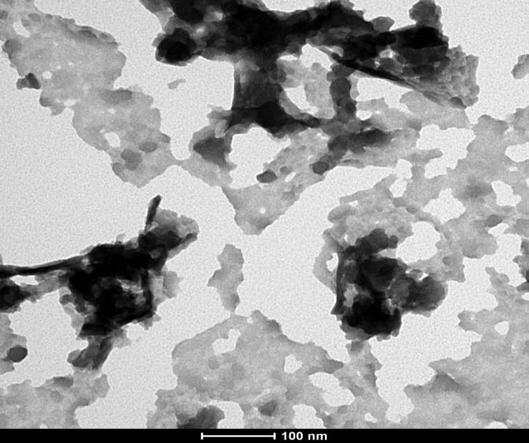
This is an example of a presentation. Pay attention when preparing your presentation to make sure the text is visible to your audience.
Figure 2: Transmission electron microscopy image of Pep 4 at pH 4.0 on day “0” (start of incubation)
Figure 3: Transmission electron microscopy image of Pep 4 at pH 7.4 on day “0” (start of incubation)
Figure 4: Transmission electron microscopy image of Pep 4 at pH 4.0 after 21 days
Figure 5: Transmission electron microscopy image of Pep 4 at pH 7.4 after 21 days

Slide 5
Amyloid fibrils
This is an example of a presentation. Pay attention when preparing your presentation to make sure the text is visible to your audience.
Content organization:
Constructed of β-sheets successively superimposed on each other;
Highly ordered
Capable of self-association
Cause diseases of amyloidogenic origin, e.g. Alzheimer's disease
Make sure each slaid is clear and readable. Use appropriate graphics, charts and photos to visually support the information presented. Try to strike a balance between text and graphics so that the message is clear and visually appealing.
6

Slide 6
Bibliography
[1] …
[2] …
[3] …

Slide 7
Acknowledgements
Participation in the conference:
University of Gdańsk, Faculty of Chemistry,
Department of Organic Chemistry
Professor --- ----
PhD --- -----
Work financed by:
Young Scientists Research No. 500-0000-B000-00
More information
Here, you can include acknowledgments and information about project funding.
8

Slide 8
This is only a suggested form of presentation preparation.
How the slides are designed (colors and fonts) and how the content is arranged is at the author's choice.
THANK YOU FOR YOUR ATTENTION
For more tips, check out the file:
„NSBC-2025-presentation_and_poster (optional performance)”
Email: john.smith@example.edu
John Smith, Jane Doe, Mark Brown
6

