Slide 1
Presenter & Co-Authors:
John Smith, Jane Doe, Mark Brown
Affiliation:
Department of Chemistry, University of Example, City, Country
(If needed, include multiple affiliations for different authors.)
Study of the fibrillization process of short peptide fragments
Contact Information:
Email: john.smith@example.edu
Website: https://nsbc.ug.edu.pl/
Date: may 10, 2025

Slide 2
SLIDE TITLE EXAMPLE
[Insert Conference Logo Here – e.g., Natural Science Baltic Conference Logo]
Presenter & Co-Authors:
Presenter: John Smith
(Underline the presenting author’s name)
Co-Authors: Jane Doe, Mark Brown
(List all authors/contributors)
More information
Affiliation:
Department of Organic Chemistry
Faculty of Chemistry, University of Gdańsk
Poster Title:
Study of the fibrillization process of short peptide fragments
Contact Information:
Email: john.smith@example.edu
Website: https://nsbc.ug.edu.pl/
Date of Presentation: may 10, 2025
3

Slide 3
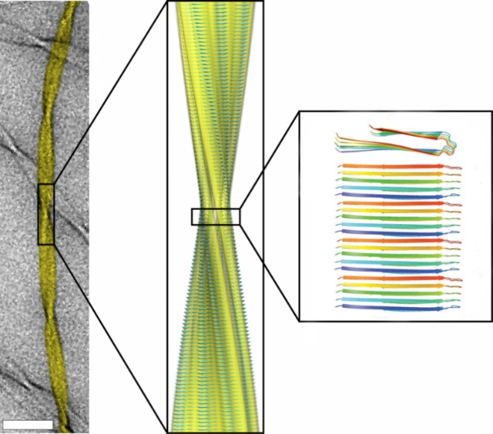
Amyloid fibrils
This is an example of a presentation. Pay attention when preparing your presentation to make sure the text is visible to your audience.
Constructed of β-sheets successively superimposed on each other;
Highly ordered
Capable of self-association
Cause diseases of amyloidogenic origin, e.g. Alzheimer's disease
Figure 1. Microscopic image of amyloid fibrils (A), model of the fibril structure (B) composed of parallel arranged beta sheet structures (C).
6

Slide 4
Amyloid fibrils
This is an example of a presentation. Pay attention when preparing your presentation to make sure the text is visible to your audience.
Content organization:
Constructed of β-sheets successively superimposed on each other;
Highly ordered
Capable of self-association
Cause diseases of amyloidogenic origin, e.g. Alzheimer's disease
Make sure each slaid is clear and readable. Use appropriate graphics, charts and photos to visually support the information presented. Try to strike a balance between text and graphics so that the message is clear and visually appealing.
6

Slide 5
Acknowledgements
Participation in the conference:
University of Gdańsk, Faculty of Chemistry,
Department of Organic Chemistry
Professor --- ----
PhD --- -----
Work financed by:
Young Scientists Research No. 500-0000-B000-00
More information
8

Slide 6
THANK YOU FOR YOUR ATTENTION
Email: john.smith@example.edu
John Smith, Jane Doe, Mark Brown
6

